Slide 1
Wafermap Analysis Report
Generated on 2026-02-23 10:45

Slide 2
Gage R&R Report - Agenda
# | Group | Parameters | Pages | Slides
1 | 📋 Agenda | - | Page 2 | 1
2 | 📖 Calculation Parameters | - | Page 3 | 1
3 | OPTIC_SPEC | 10 | Page 4-8 | 5
4 | 📍 Stitched - Pixel Position based | 5 dies | Page 9-14 | 6
Total: 4 Groups | 10 Parameters | 13 Slides

Slide 3
Gage R&R - Calculation Parameters
BASIC STATISTICAL VALUES
Mean (Mittelwert):
Average of all measurements across all files and dies.
Mean = Σ(xi) / n
Std Dev (Standardabweichung):
Measure of dispersion around the mean.
σ = √[Σ(xi - Mean)² / n]
Range (Spannweite):
Difference between maximum and minimum.
Range = Max - Min
LSL / USL (Spec Limits):
Statistical limits (k = sigma factor).
LSL = Mean - kσ | USL = Mean + kσ
GAGE R&R COMPONENTS
Repeatability (EV):
Variation within measurements of one file (equipment).
EV = Mean(σ within each file)
Reproducibility (AV):
Variation between files/operators/trials.
AV = σ(file means)
GRR Total:
Combined measurement system variation.
GRR = R̄ / d₂ (Range Method)
ASSESSMENT METRICS
%GRR (Prozent GRR):
GRR as percentage of total variation or tolerance.
%GRR = (GRR / TV) × 100 or (GRR / Tolerance) × 100
ndc (Using Total Variation):
Number of distinct categories the system can distinguish.
ndc = 1.41 × (TV / GRR)
ASSESSMENT CRITERIA (AIAG MSA)
🟢 EXCELLENT: %GRR < 10%
Measurement system is acceptable.
🟡 ACCEPTABLE: 10% ≤ %GRR < 30%
May be acceptable depending on application.
🔴 UNACCEPTABLE: %GRR ≥ 30%
Measurement system must be improved.
ndc ≥ 5: Good measurement system
Can distinguish ≥ 5 distinct categories.
INTERPRETATION
• High Repeatability → Equipment/method problem
• High Reproducibility → Operator/process/time problem
• ndc should be ≥ 5 for a good measurement system
• Values outside LSL/USL indicate outliers

Slide 4
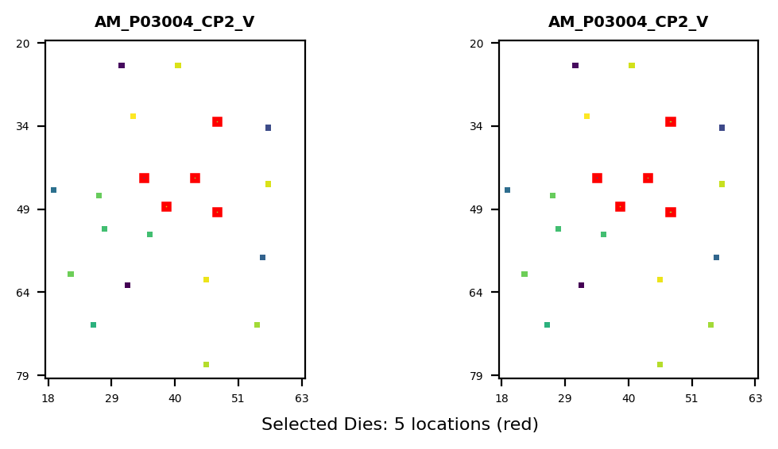
Gage R&R Study Overview - OPTIC_SPEC
Study Configuration
• Files/Trials: 2 • Dies/Parts: 5 • Parameters: 11
Parameters Analyzed:
1. 12035000: TRO_DOMWLTH_CENTER_AVEE*-DACI*-DC*_
2. 12035001: TRO_PKWLTH_CENTER_AVEE*-DACI*-DC*_F
3. 12035002: TRO_CETLTH_CENTER_AVEE*-DACI*-DC*_F
4. 12036000: TRO_FWHM_CENTER_AVEE*-DACI*-DC*_FRE
5. 12035003: TRO_SIGNAL_CENTER_AVEE*-DACI*-DC*_F
6. 12035004: TRO_COLORX_CENTER_AVEE*-DACI*-DC*_F
7. 12035005: TRO_COLORY_CENTER_AVEE*-DACI*-DC*_F
8. 30015004: TRO_NDFILTER_CENTER_AVEE*-DACI*-DC*
... +2 more
Overall Result: FAIL
✗ Gage R&R FAILED for 2 parameter(s) due to excessive measurement variation (>30%). Failing parameters: OPTIC_SPECTRO_TESTTIME_TI, OPTIC_SPECTRO_FWHM_CENTER Recommendation: Review measurement equipment, operator training, or test methodology.
Assessment: 6 Excellent | 2 Acceptable | 2 Unacceptable

Slide 5
Gage R&R - Calculation Parameters (Formulas)
BASIC STATISTICAL VALUES
Mean (Mittelwert):
Average of all measurements across all files and dies.
Mean = Σ(xi) / n
Std Dev (Standardabweichung):
Measure of dispersion around the mean.
σ = √[Σ(xi - Mean)² / n]
Range (Spannweite):
Difference between maximum and minimum.
Range = Max - Min
LSL / USL (Spec Limits):
Statistical limits (k = sigma factor).
LSL = Mean - kσ | USL = Mean + kσ
GAGE R&R COMPONENTS
Repeatability (EV):
Variation within measurements of one file (equipment).
EV = Mean(σ within each file)
Reproducibility (AV):
Variation between files/operators/trials.
AV = σ(file means)
GRR Total:
Combined measurement system variation.
GRR = R̄ / d₂ (Range Method)
Part Variation (PV):
True variation between parts/dies.
PV = σ(part means)
Total Variation (TV):
Total observed variation.
TV = √(PV² + GRR²)
ASSESSMENT METRICS
%GRR (Prozent GRR):
GRR as percentage of total variation or tolerance.
%GRR = (GRR / TV) × 100 or (GRR / Tolerance) × 100
ndc (Using Part Variation):
Number of distinct categories the system can distinguish.
ndc = 1.41 × (PV / GRR)
ASSESSMENT CRITERIA (AIAG MSA)
🟢 EXCELLENT: %GRR < 10%
Measurement system is acceptable.
🟡 ACCEPTABLE: 10% ≤ %GRR < 30%
May be acceptable depending on application.
🔴 UNACCEPTABLE: %GRR ≥ 30%
Measurement system must be improved.
ndc ≥ 5: Good measurement system
Can distinguish ≥ 5 distinct categories.
INTERPRETATION
• High Repeatability → Equipment/method problem
• High Reproducibility → Operator/process/time problem
• ndc should be ≥ 5 for a good measurement system
• Values outside LSL/USL indicate outliers

Slide 6
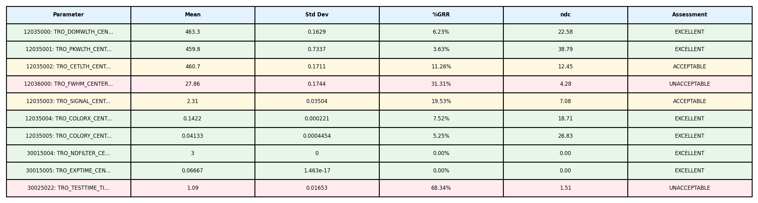
Gage R&R Analysis Summary - OPTIC_SPEC
Study Information: • Files (Operators/Trials): 2 • Dies (Parts): 5 • Parameters Analyzed: 11

Slide 7
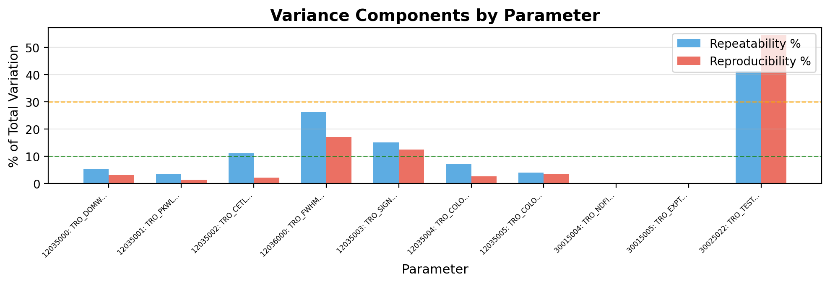
Gage R&R - Variance Components - OPTIC_SPEC
Interpretation:
• Repeatability (blue): Variation when same operator measures same part multiple times (equipment variation)
• Reproducibility (red): Variation between different operators/trials measuring same part (operator variation)
→ Analysis: Repeatability (11.3%) > Reproducibility (9.7%). Equipment/method variation is dominant. Consider equipment calibration or method refinement.

Slide 8
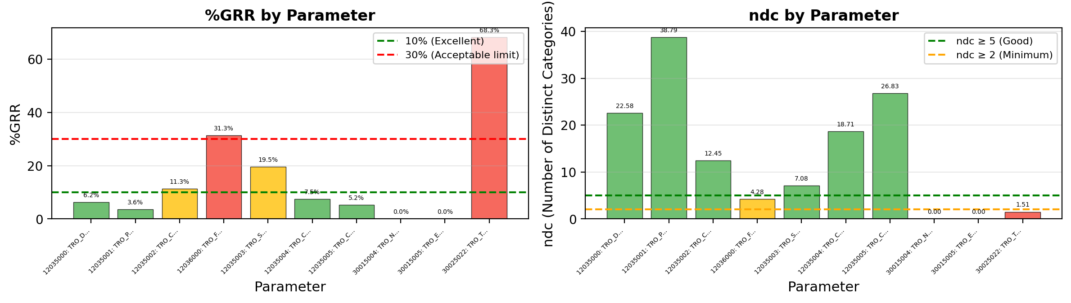
Gage R&R - %GRR and ndc - OPTIC_SPEC
Acceptance Criteria & Interpretation:
• %GRR < 10%: EXCELLENT - Measurement system is excellent for this application
• %GRR 10-30%: ACCEPTABLE - May be acceptable depending on application criticality
• %GRR > 30%: UNACCEPTABLE - Measurement system needs improvement
• ndc (Number of Distinct Categories): Indicates how many distinct categories the measurement can reliably distinguish. ndc ≥ 5 is recommended.
⚠ Warning: 4 parameter(s) have ndc < 5: OPTIC_SPECTRO_FWHM_C, OPTIC_SPECTRO_NDFILT, OPTIC_SPECTRO_EXPTIM

Slide 9
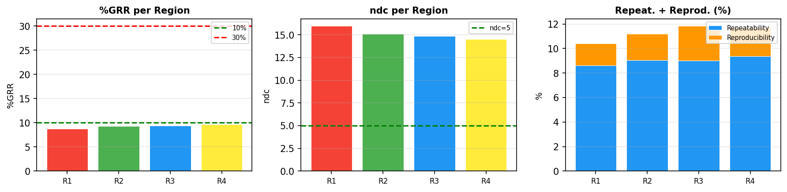
PLM Pixel Analysis - Stitched - Die (35,44)
Region | Position | Size | %GRR | ndc | Repeat.% | Reprod.% | Result
R1 | (193,330)->(218,355) | 25x25 | 8.8% | 15.9 | 8.6% | 1.8% | EXCELLENT
R2 | (192,390)->(217,415) | 25x25 | 9.3% | 15.1 | 9.0% | 2.1% | EXCELLENT
R3 | (329,383)->(354,408) | 25x25 | 9.4% | 14.9 | 9.0% | 2.8% | EXCELLENT
R4 | (197,446)->(222,471) | 25x25 | 9.7% | 14.5 | 9.4% | 2.3% | EXCELLENT
Die (35, 44)
PLM Type: Stitched
Regions: 4
Files/Trials: 2
Pixels/Region: 625
Best: R1 - %GRR=8.8%
Worst: R4 - %GRR=9.7%

Slide 10
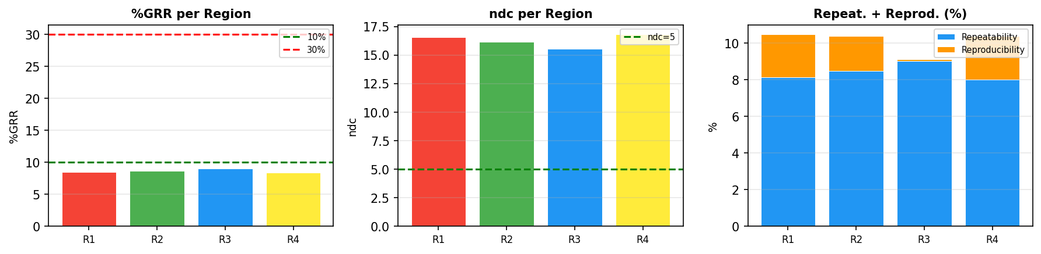
PLM Pixel Analysis - Stitched - Die (39,49)
Region | Position | Size | %GRR | ndc | Repeat.% | Reprod.% | Result
R1 | (193,330)->(218,355) | 25x25 | 8.5% | 16.6 | 8.1% | 2.3% | EXCELLENT
R2 | (192,390)->(217,415) | 25x25 | 8.7% | 16.2 | 8.5% | 1.9% | EXCELLENT
R3 | (329,383)->(354,408) | 25x25 | 9.0% | 15.5 | 9.0% | 0.1% | EXCELLENT
R4 | (197,446)->(222,471) | 25x25 | 8.4% | 16.8 | 8.0% | 2.4% | EXCELLENT
Die (39, 49)
PLM Type: Stitched
Regions: 4
Files/Trials: 2
Pixels/Region: 625
Best: R4 - %GRR=8.4%
Worst: R3 - %GRR=9.0%

Slide 11
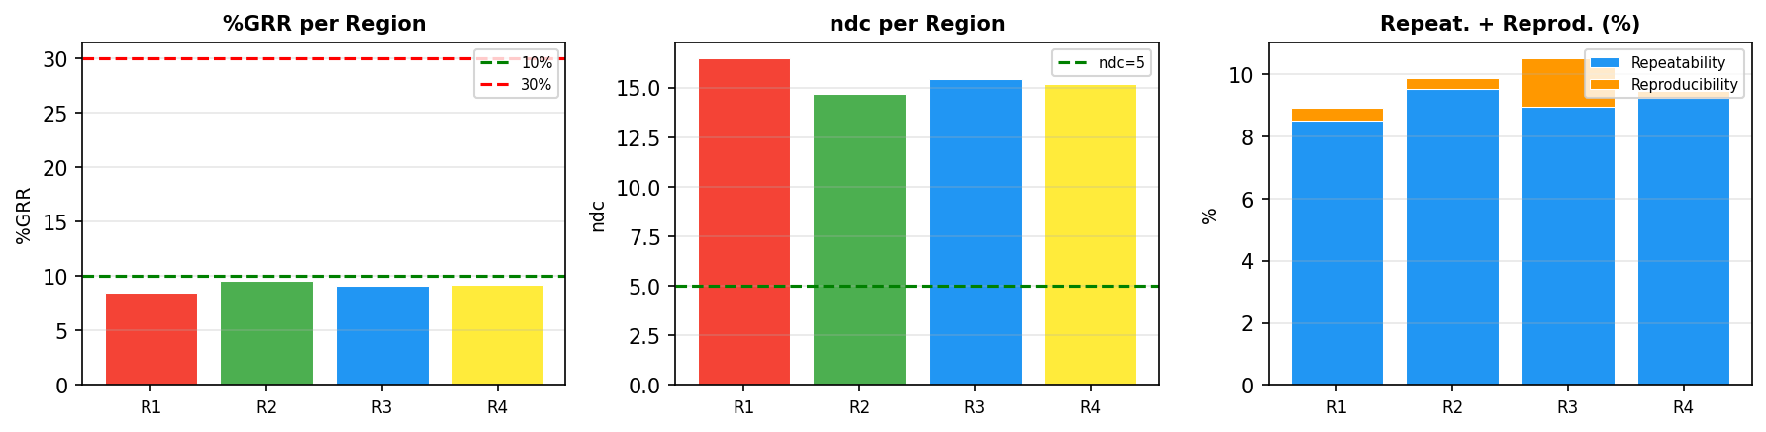
PLM Pixel Analysis - Stitched - Die (44,44)
Region | Position | Size | %GRR | ndc | Repeat.% | Reprod.% | Result
R1 | (193,330)->(218,355) | 25x25 | 8.5% | 16.5 | 8.5% | 0.4% | EXCELLENT
R2 | (192,390)->(217,415) | 25x25 | 9.5% | 14.7 | 9.5% | 0.4% | EXCELLENT
R3 | (329,383)->(354,408) | 25x25 | 9.1% | 15.4 | 9.0% | 1.6% | EXCELLENT
R4 | (197,446)->(222,471) | 25x25 | 9.2% | 15.2 | 9.2% | 0.2% | EXCELLENT
Die (44, 44)
PLM Type: Stitched
Regions: 4
Files/Trials: 2
Pixels/Region: 625
Best: R1 - %GRR=8.5%
Worst: R2 - %GRR=9.5%

Slide 12
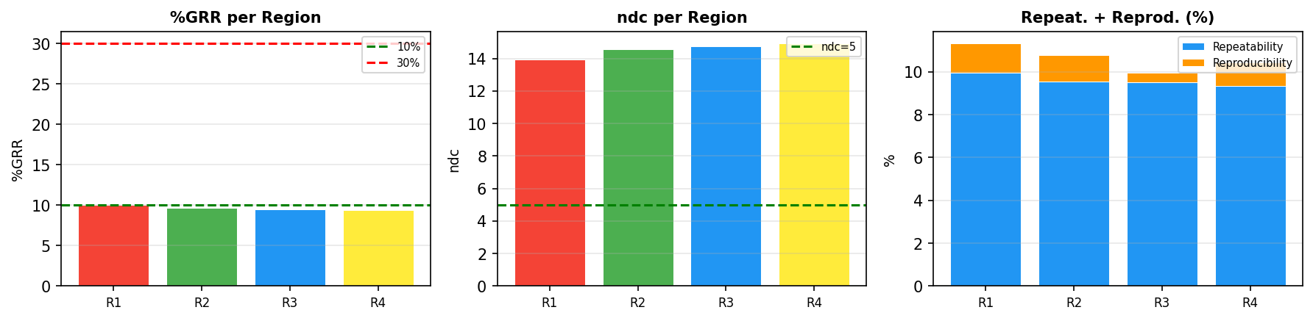
PLM Pixel Analysis - Stitched - Die (48,34)
Region | Position | Size | %GRR | ndc | Repeat.% | Reprod.% | Result
R1 | (193,330)->(218,355) | 25x25 | 10.1% | 13.9 | 10.0% | 1.3% | ACCEPTABLE
R2 | (192,390)->(217,415) | 25x25 | 9.6% | 14.6 | 9.6% | 1.2% | EXCELLENT
R3 | (329,383)->(354,408) | 25x25 | 9.5% | 14.8 | 9.5% | 0.5% | EXCELLENT
R4 | (197,446)->(222,471) | 25x25 | 9.4% | 14.9 | 9.3% | 1.1% | EXCELLENT
Die (48, 34)
PLM Type: Stitched
Regions: 4
Files/Trials: 2
Pixels/Region: 625
Best: R4 - %GRR=9.4%
Worst: R1 - %GRR=10.1%

Slide 13
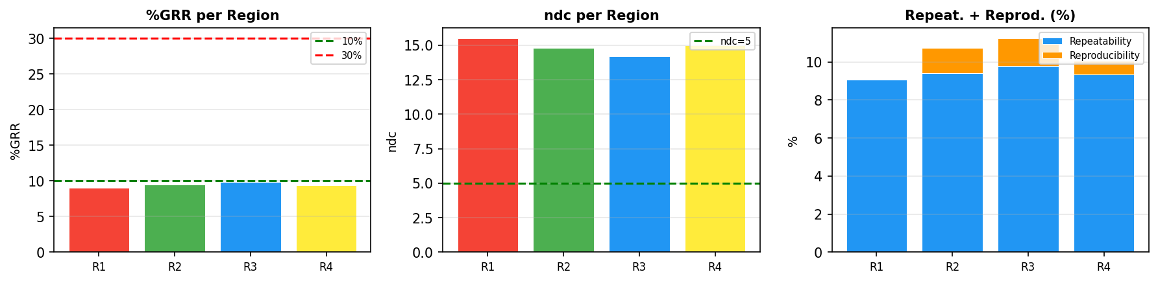
PLM Pixel Analysis - Stitched - Die (48,50)
Region | Position | Size | %GRR | ndc | Repeat.% | Reprod.% | Result
R1 | (193,330)->(218,355) | 25x25 | 9.1% | 15.5 | 9.1% | 0.0% | EXCELLENT
R2 | (192,390)->(217,415) | 25x25 | 9.5% | 14.8 | 9.4% | 1.3% | EXCELLENT
R3 | (329,383)->(354,408) | 25x25 | 9.9% | 14.2 | 9.8% | 1.5% | EXCELLENT
R4 | (197,446)->(222,471) | 25x25 | 9.4% | 15.0 | 9.3% | 0.7% | EXCELLENT
Die (48, 50)
PLM Type: Stitched
Regions: 4
Files/Trials: 2
Pixels/Region: 625
Best: R1 - %GRR=9.1%
Worst: R3 - %GRR=9.9%

Slide 14
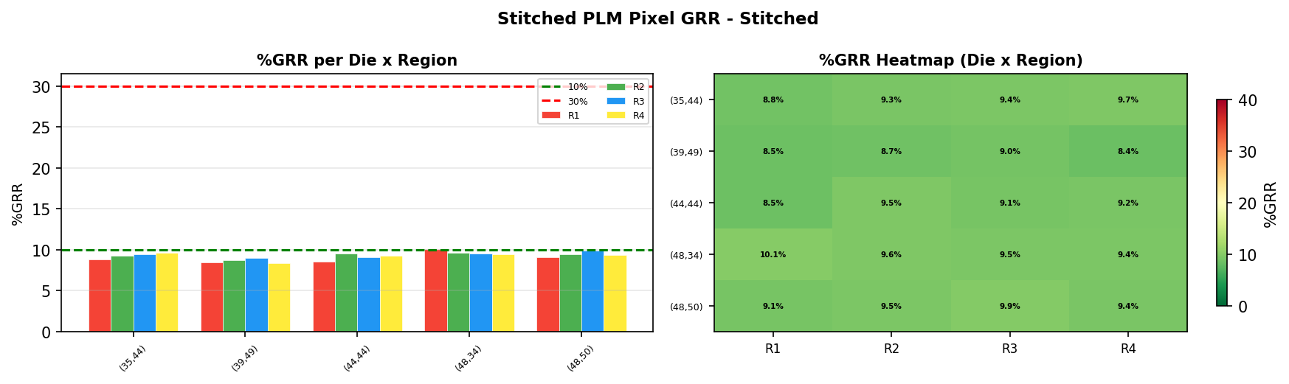
PLM Pixel Analysis - Stitched Overview - Stitched
Die | R1 %GRR | R2 %GRR | R3 %GRR | R4 %GRR | Avg %GRR
(35,44) | 8.8% | 9.3% | 9.4% | 9.7% | 9.3%
(39,49) | 8.5% | 8.7% | 9.0% | 8.4% | 8.6%
(44,44) | 8.5% | 9.5% | 9.1% | 9.2% | 9.1%
(48,34) | 10.1% | 9.6% | 9.5% | 9.4% | 9.7%
(48,50) | 9.1% | 9.5% | 9.9% | 9.4% | 9.5%
Stitched Die Comparison
PLM Type: Stitched
Total Dies: 5
Regions per Die: 4
Files/Trials: 2
Best: Die(39,49) R4 - 8.4%
Worst: Die(48,34) R1 - 10.1%

